Slide 1
JEAN AND ALAN WRIGHTS GARDEN
Baulkham Hills
Presentation to Members’ Meeting 24 September 2021

Slide 2
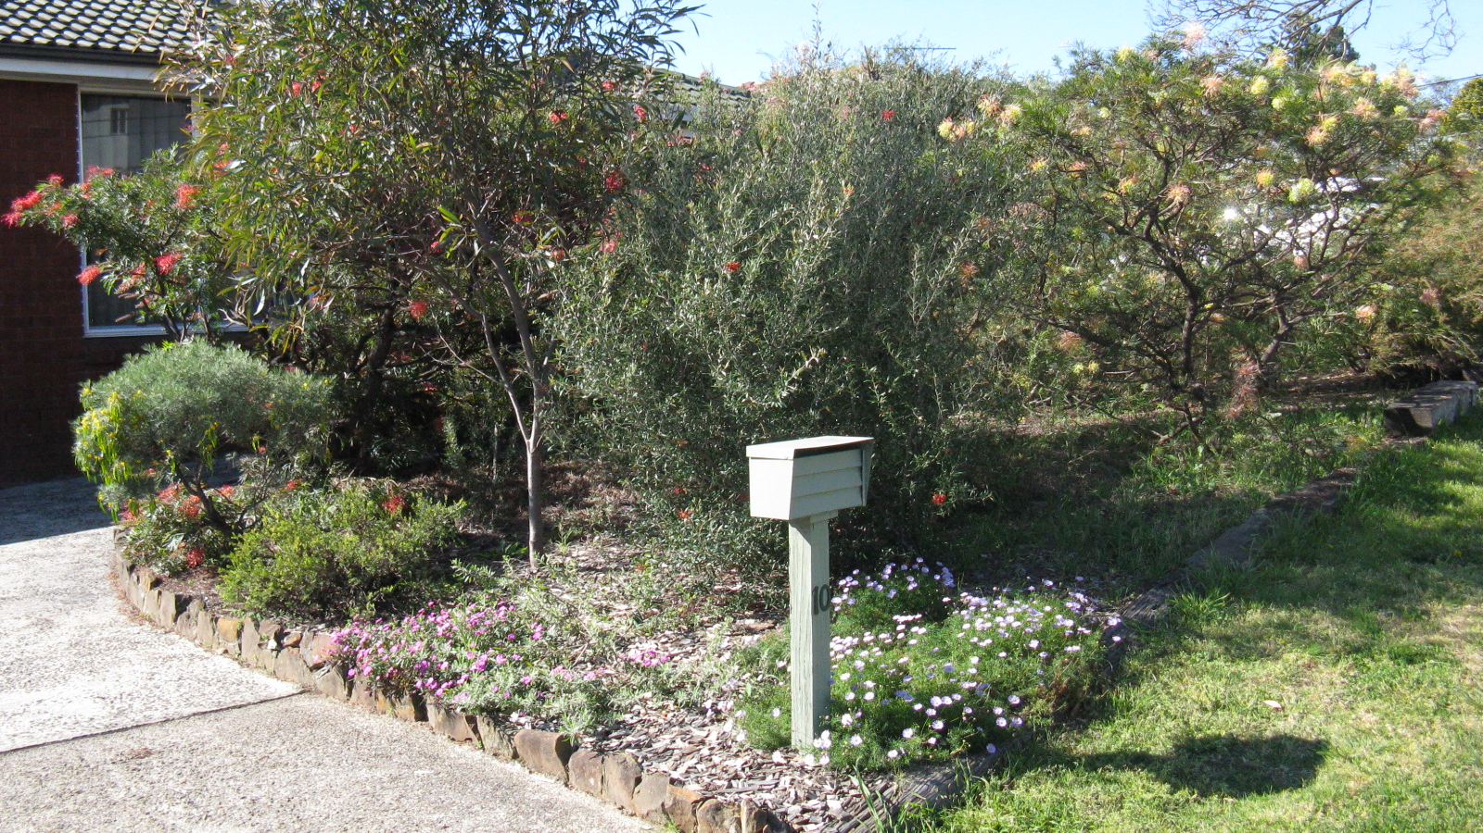
Front garden

Slide 3
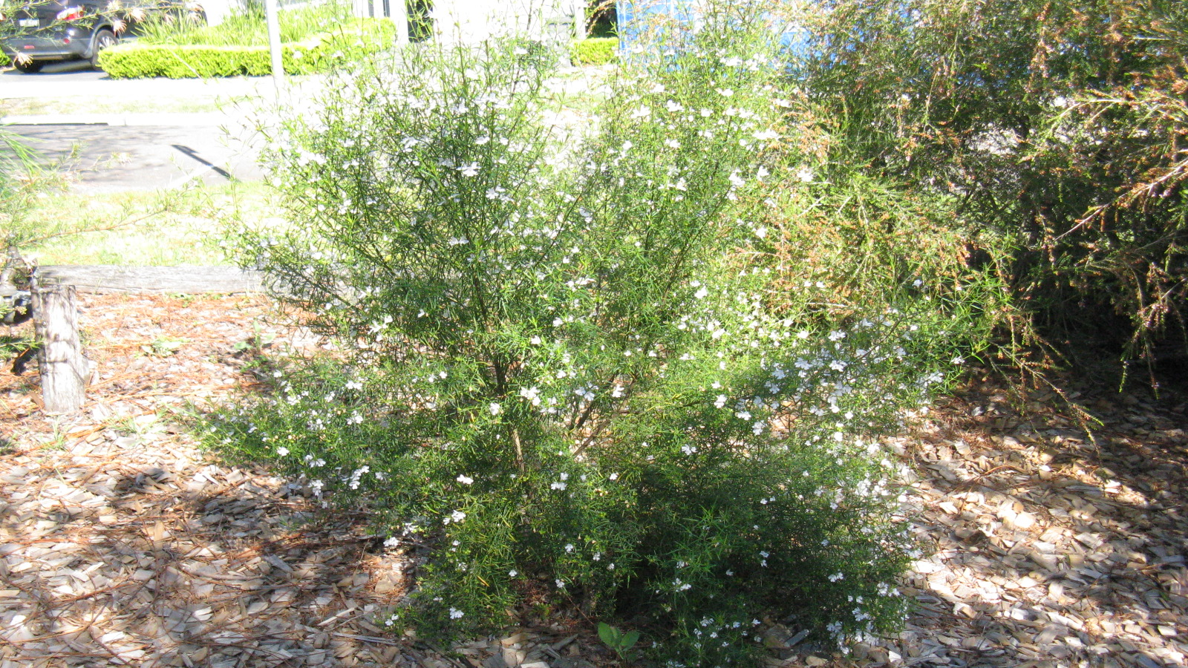
Westringia longifolia

Slide 4
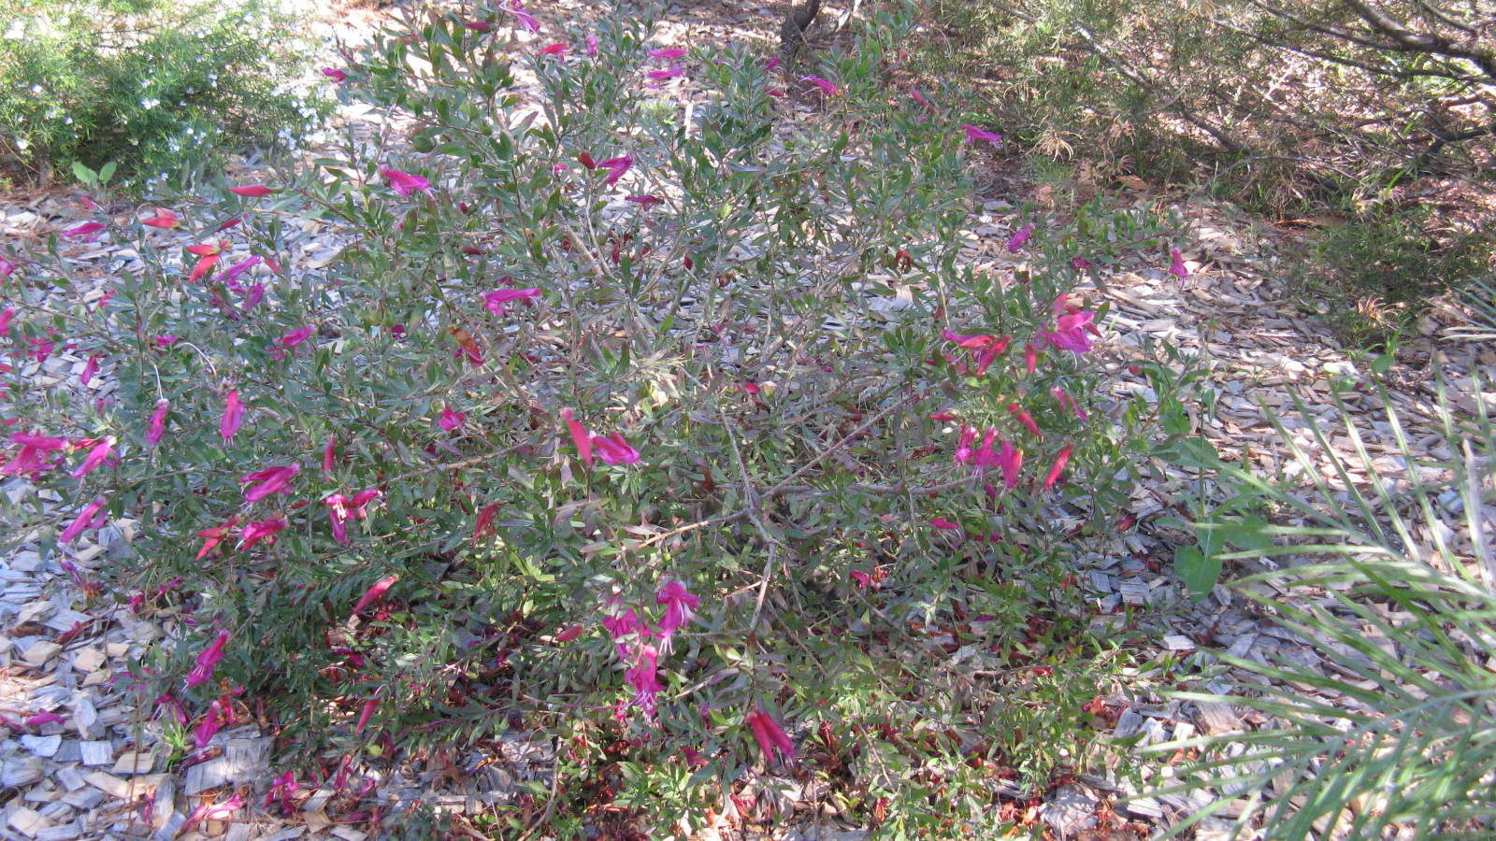
Eremophila maculata ‘Magic Blush’

Slide 5
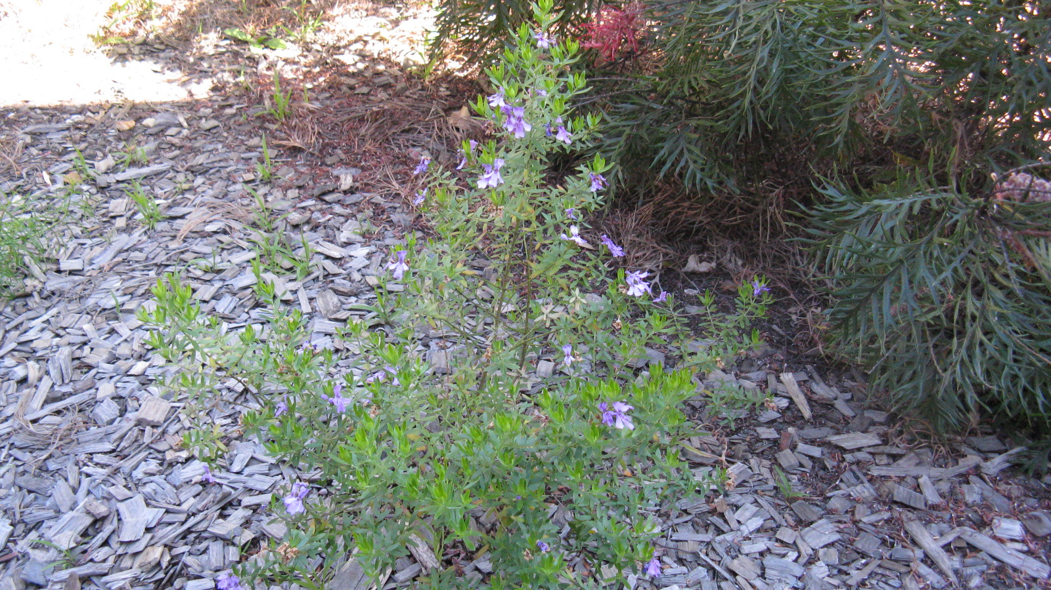
Westringia sp. (purple)

Slide 6
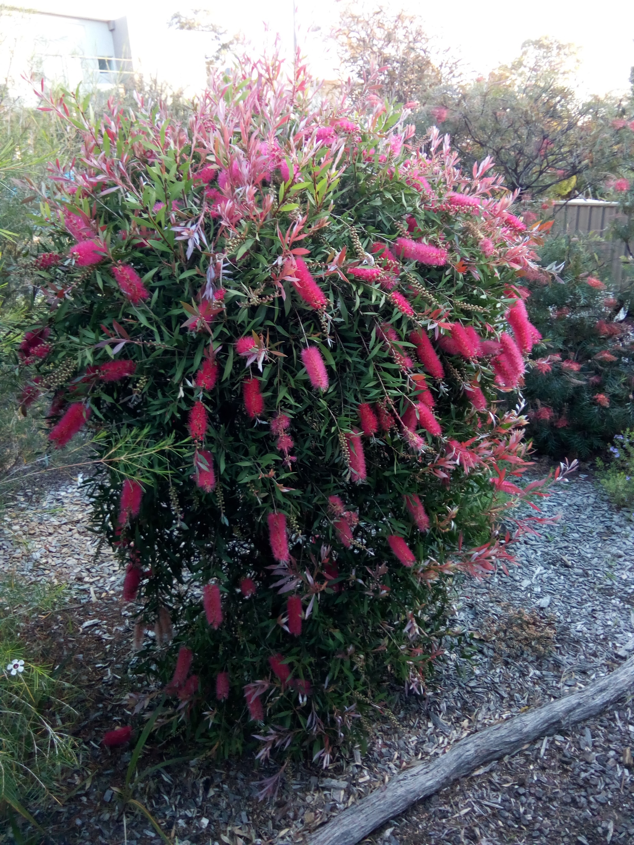
Callistemon ‘Taree Pink’

Slide 7
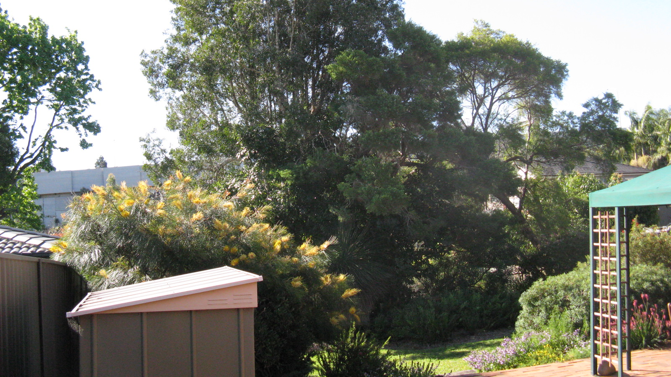
View down back garden

Slide 8
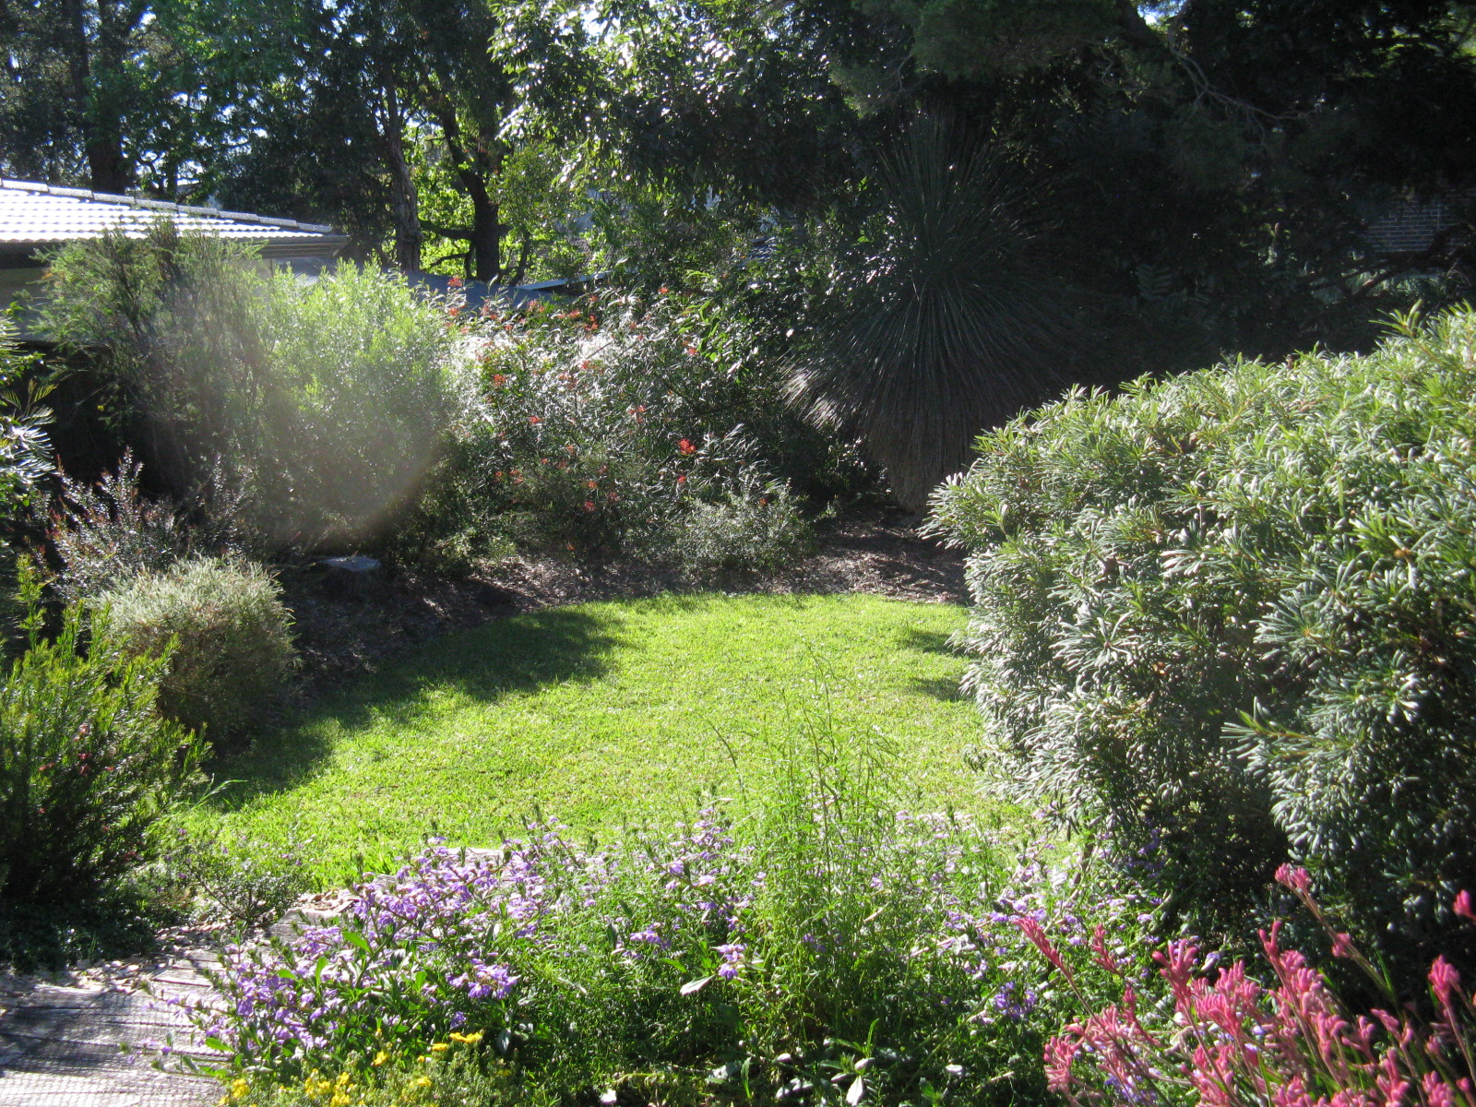
View from gazebo

Slide 9
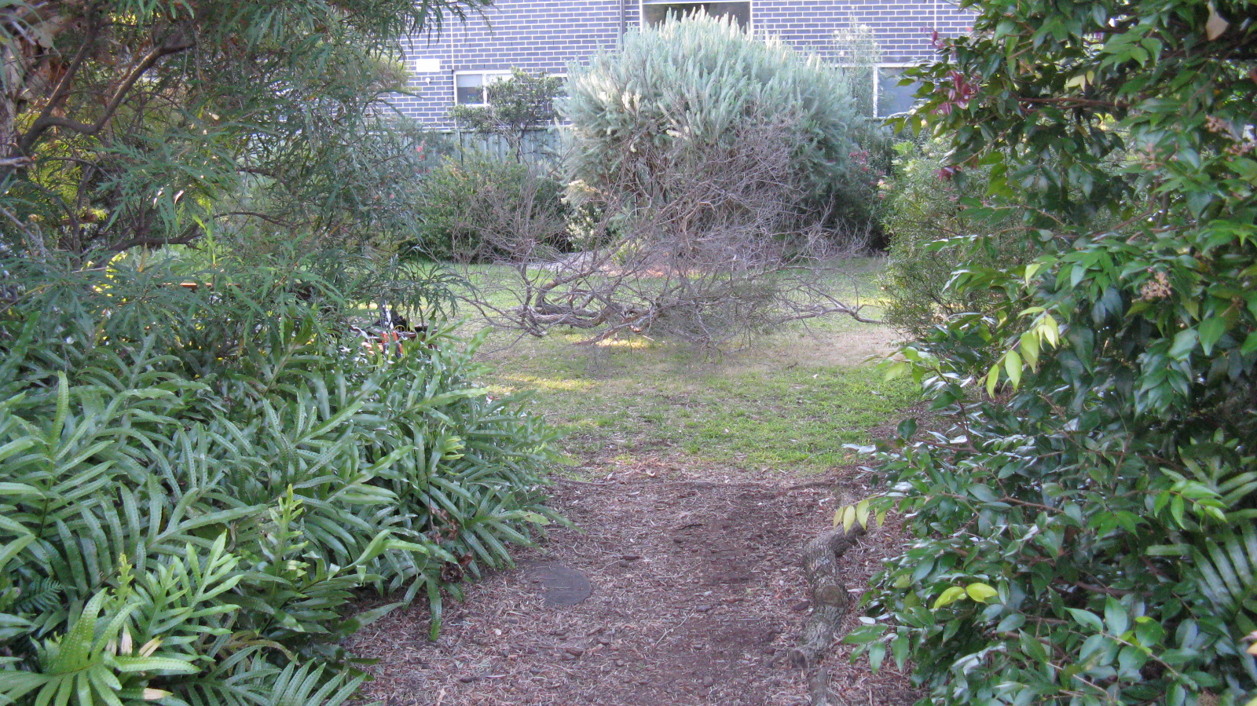
View from garden seat

Slide 10
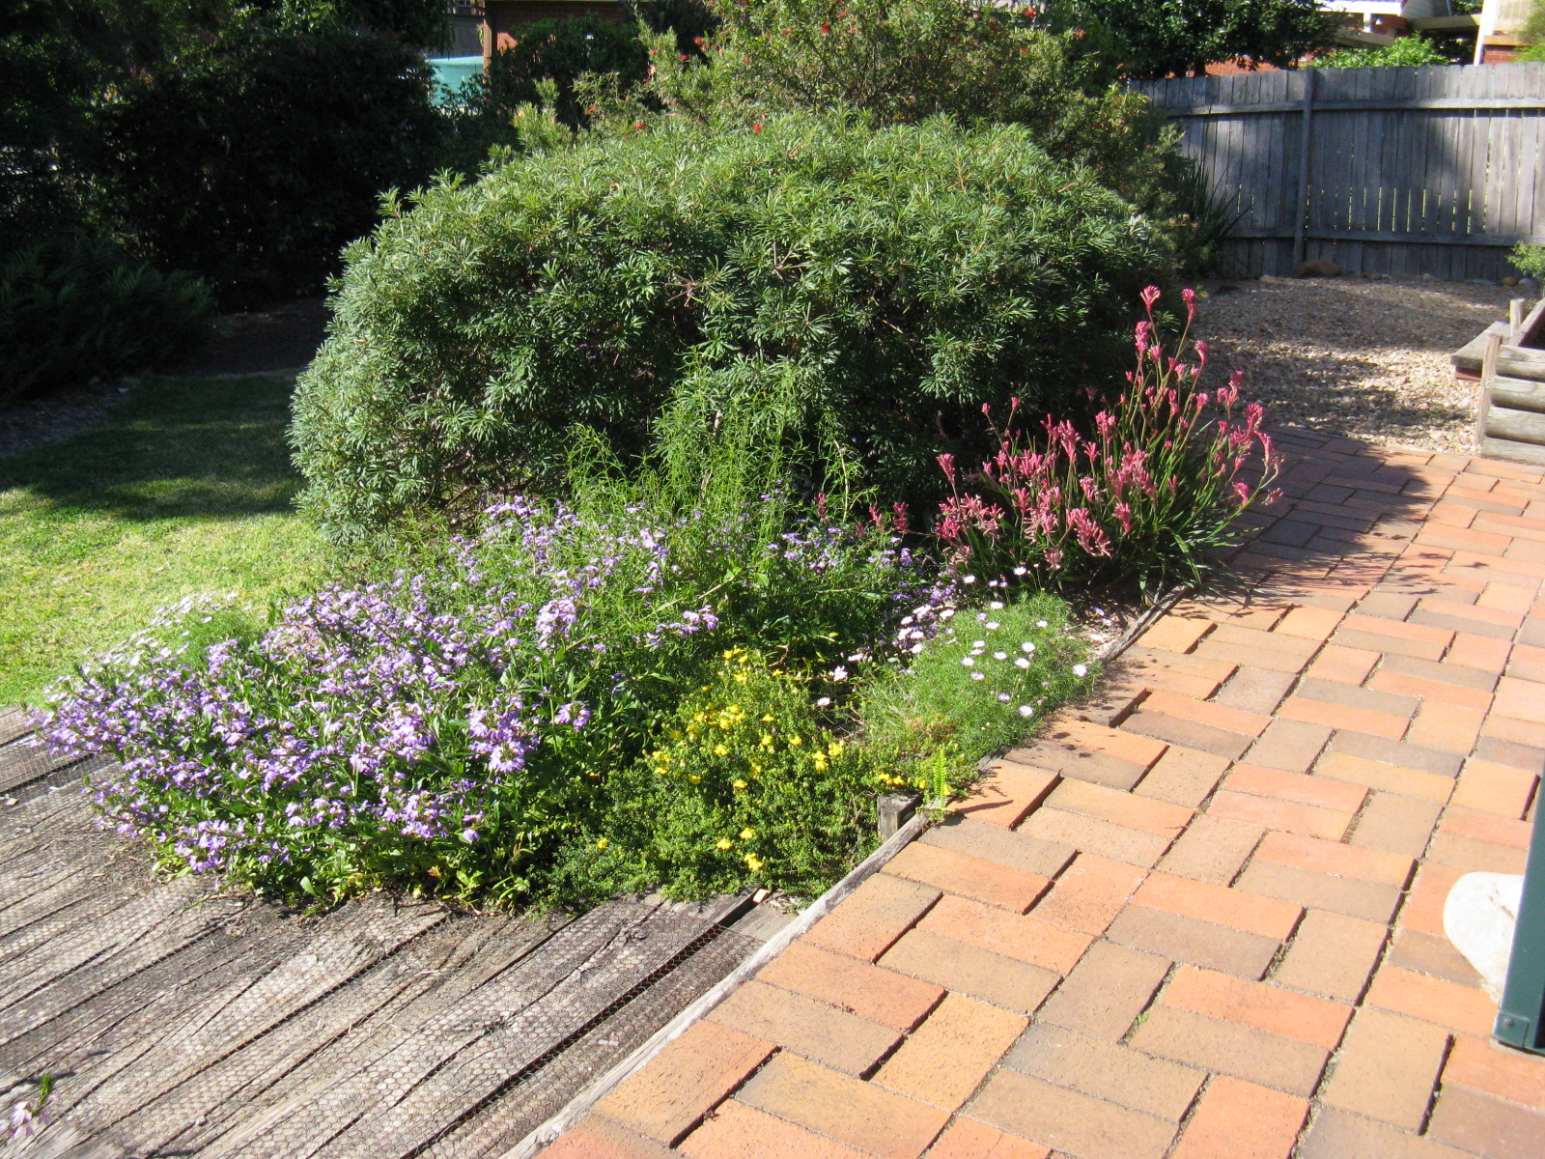

Slide 11
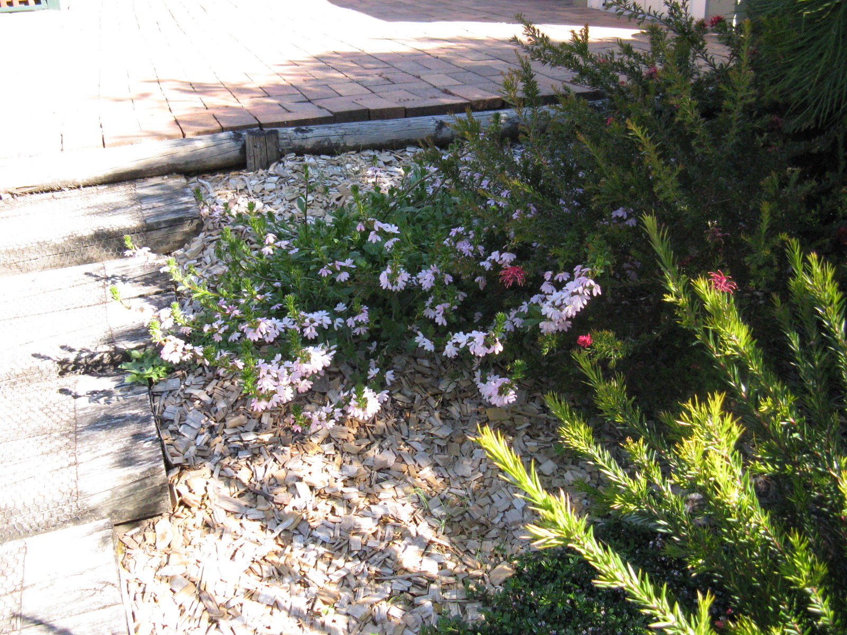
Scaevola (pink)

Slide 12
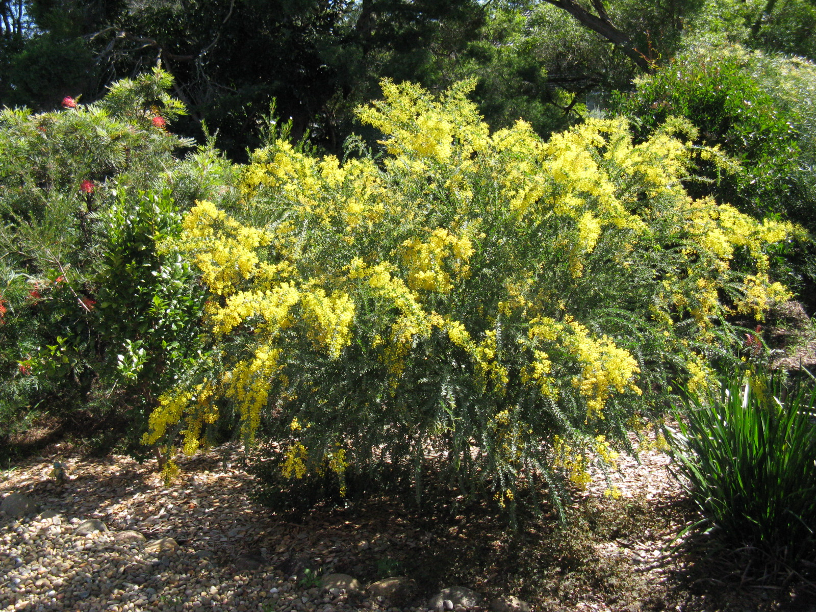
A. vestita

Slide 13
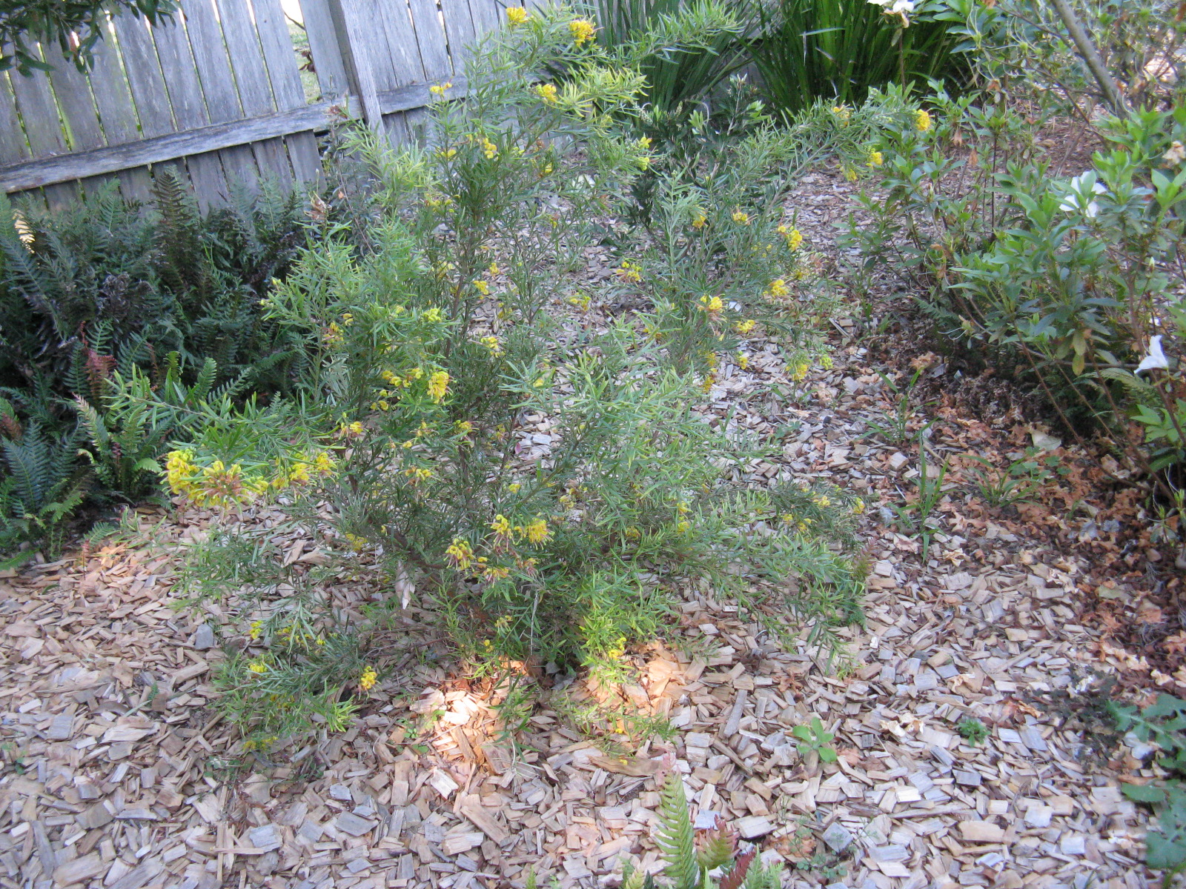
G. ‘Goldrush’

Slide 14
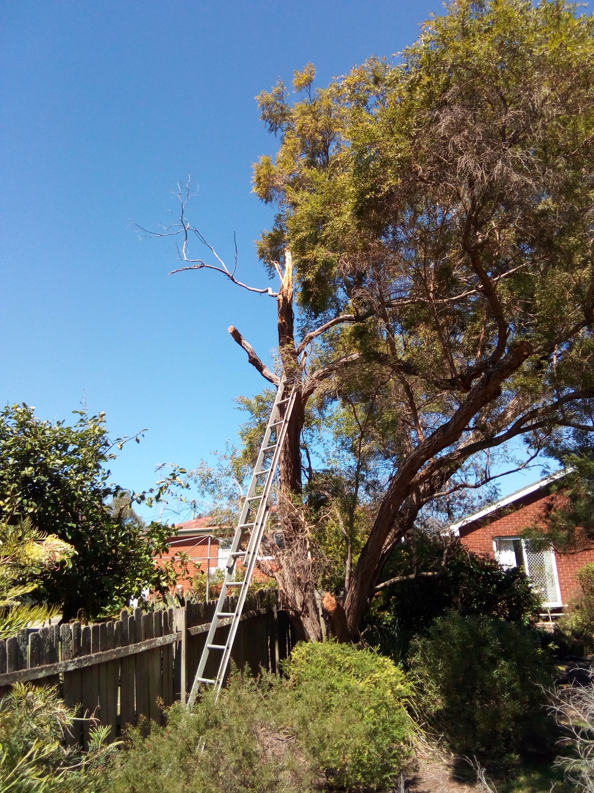
Leptospermum petersonii after losing its top in a storm

Slide 15
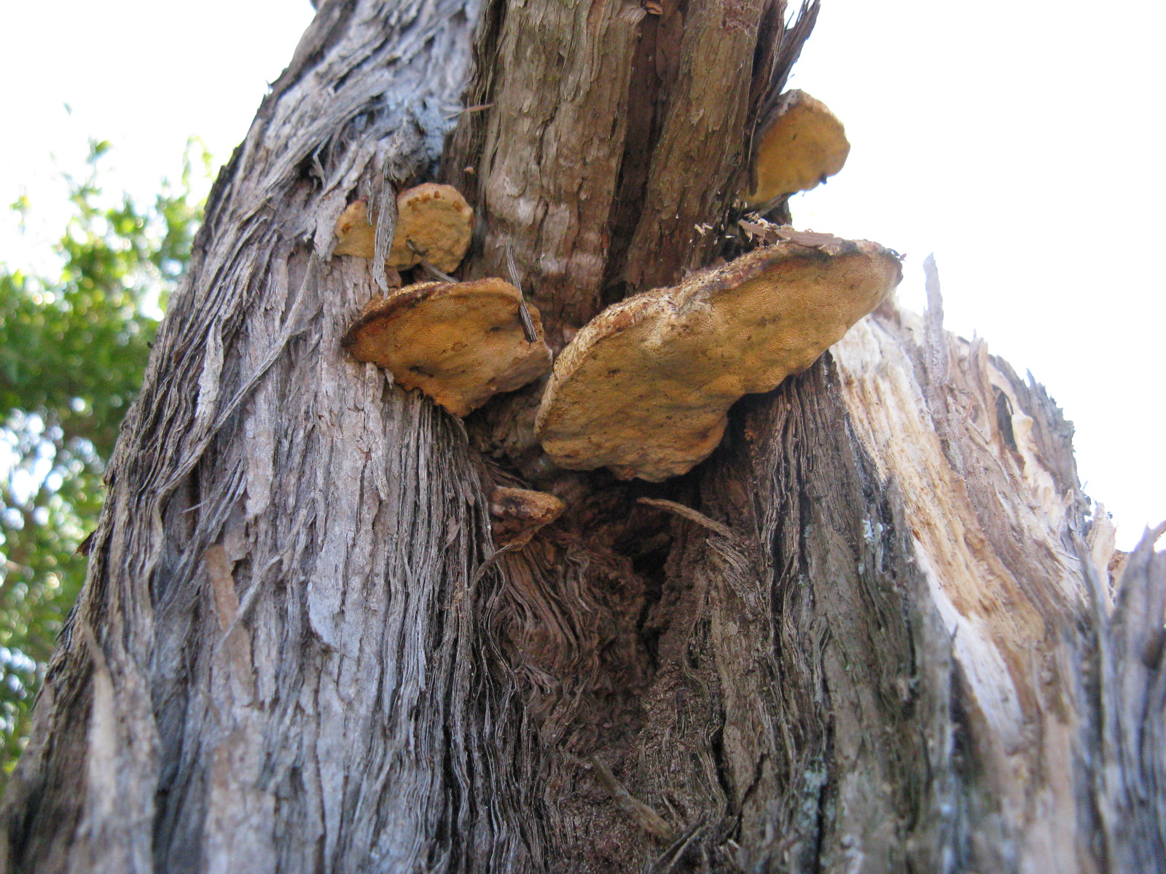
Bracket fungus on L. petersonii

Slide 16
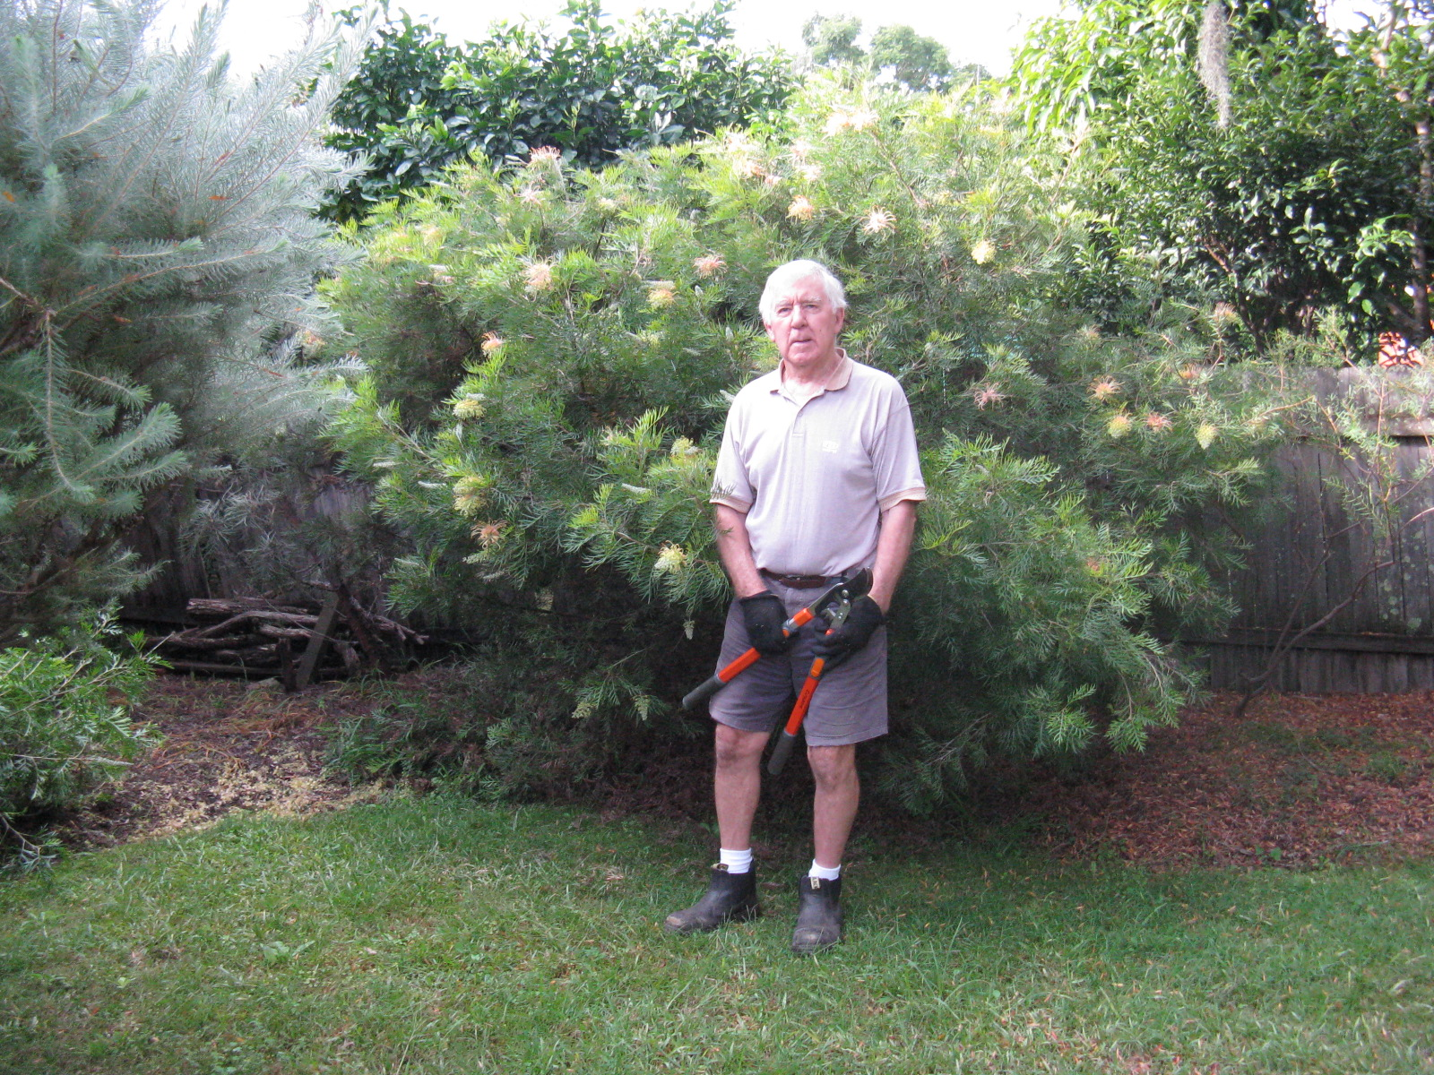
G. Peaches and Cream

Slide 17
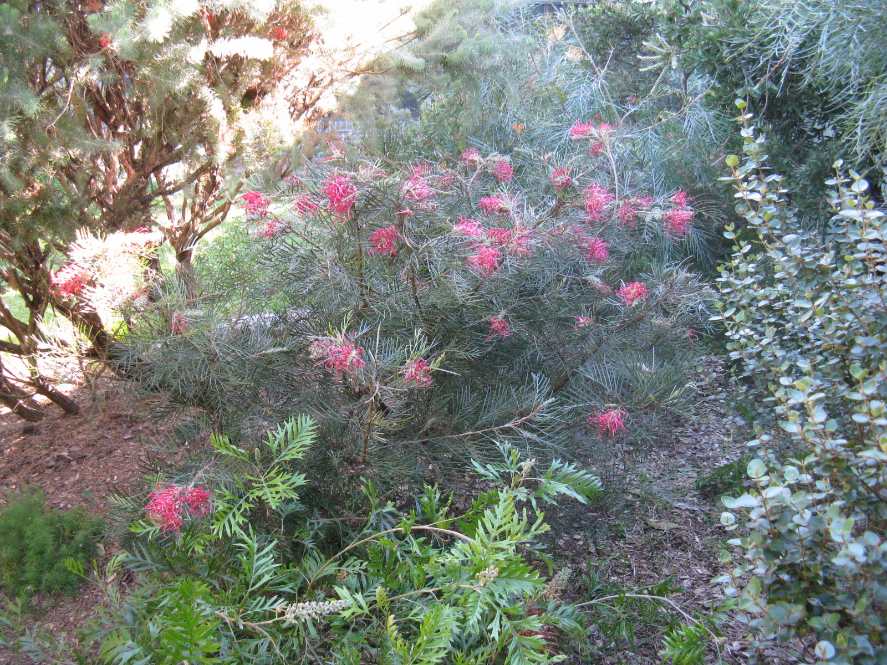
G. ‘Lollipops’

Slide 18
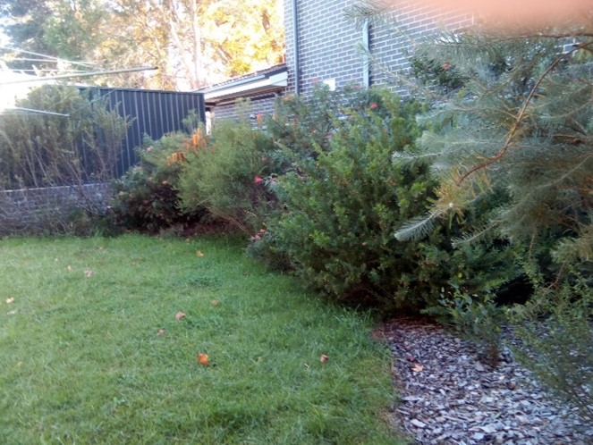

Slide 19
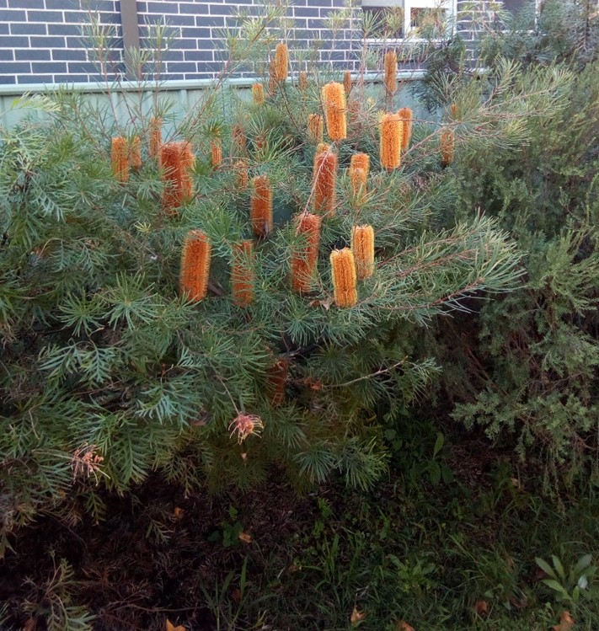
B. spinulosa

